Slide 1
Lecture 13: Natural Language Processing
A brief overview of the field: problems, models, and breakthroughs
MIT
6.390
Chris Tanner

Slide 2
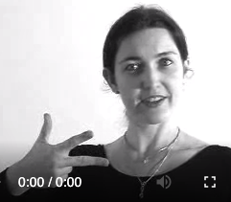
Language symbols are encoded as continuous communication signals, and are invariant across different encodings (same underlying concept, different surface forms)
Slide adapted from or inspired by Chris Manning and Richard Socher

Slide 3
Language is funny
“Red tape holds up new bridges”
“Hospitals are sued by 7 foot doctors”
“Local high school dropouts cut in half”
“Tesla crashed today”
“Obama announced that he will run again”
“Kipchoge announced that he will run again”
“She made him duck”
“Will you visit the bank across from the river bank? You can bank on it”
“Yes” vs “Yes.” vs “YES” vs “YES!” vs “YAS” vs “Yea”

Slide 4
Language is funny
“Maria likes May”
“Maria likes May and Joe”
“Maria likes May and June”
“May likes Maria”
“Maria hit May, then she [fell/ran]”
“Maria and Anqi bullied May, so they got in trouble”
“Maria and Anqi convinced May to prank the teacher, so they got in trouble”
“May may like May, but she really likes June.”

Slide 5
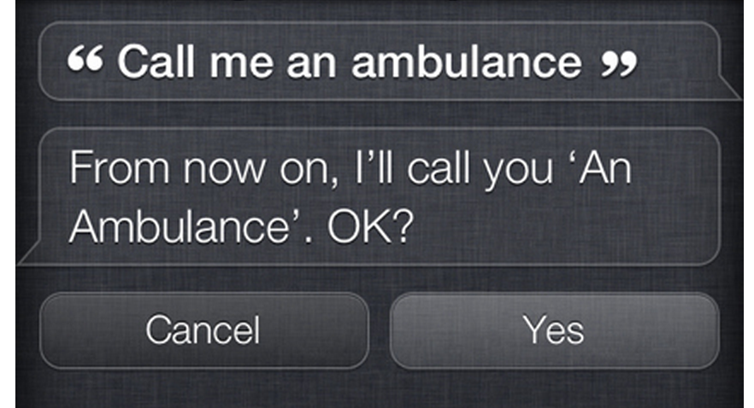
Language is funny

Slide 6
Language is funny
Natural language is:
Ambiguous
Noisy
Subtle
Grounded
Diverse
High-dimensional
Beautiful!

Slide 7
Multiple levels* to a single word
Many ways to express the same meaning
Infinite meanings can be expressed
Languages widely differ in these complex interactions
Discourse
Pragmatics
Semantics
Syntax
Lexemes
Morphology
*
phonology
orthography
phonetics
text
speech

Slide 8
Common NLP Tasks (aka problems)
Syntax
Semantics
Morphology
Word Segmentation
Part-of-Speech Tagging
Parsing
Constituency
Dependency
Sentiment Analysis
Topic Modelling
Named Entity Recognition (NER)
Relation Extraction
Word Sense Disambiguation
Natural Language Understanding (NLU)
Natural Language Generation (NLG)
Machine Translation
Entailment
Question Answering
Language Modelling
Discourse
Summarization
Coreference Resolution

Slide 9
Common NLP Tasks (aka problems)
Syntax
Semantics
Morphology
Word Segmentation
Part-of-Speech Tagging
Parsing
Constituency
Dependency
Sentiment Analysis
Topic Modelling
Named Entity Recognition (NER)
Relation Extraction
Word Sense Disambiguation
Natural Language Understanding (NLU)
Natural Language Generation (NLG)
Machine Translation
Entailment
Question Answering
Language Modelling
“Alexa, play Drivers License by Olivia Rodrigo”
“Alexa, play Drivers License by Olivia Rodrigo”
INTENT
SONG
ARTIST
Discourse
Summarization
Coreference Resolution

Slide 10
Common NLP Tasks (aka problems)
Syntax
Semantics
Morphology
Word Segmentation
Part-of-Speech Tagging
Parsing
Constituency
Dependency
Sentiment Analysis
Topic Modelling
Named Entity Recognition (NER)
Relation Extraction
Word Sense Disambiguation
Natural Language Understanding (NLU)
Natural Language Generation (NLG)
Machine Translation
Entailment
Question Answering
Language Modelling
PERSON
LOCATION
TIME
“Barack Obama is expected to speak at the White House Sept 20”
Discourse
Summarization
Coreference Resolution

Slide 11
Very brief history of NLP
1960s: pattern-matching and rules (highly limiting)
1970s & 1980s: linguistically rich, logic-driven systems; labor-intensive successes on a few, very specific tasks
1990s & 2000s: statistical modelling takeover! ML becomes a central component; some systems are deployed for practical use (e.g., speech to text)
2010s: Deep Learning (neural nets) yields astronomical progress on nearly every NLP task; systems become fairly useful for consumers
2020s : Generative LMs take over the world?

Slide 12
FEB 2019: GPT-2
Transformer Decoder LM (generative; auto-regressive)
Amazing ability for translation, question-answering, summarization, etc
First model that could generate text that kind of, almost, looked human-generated.
Language Models are Unsupervised Multitask Learners (2019)

Slide 13
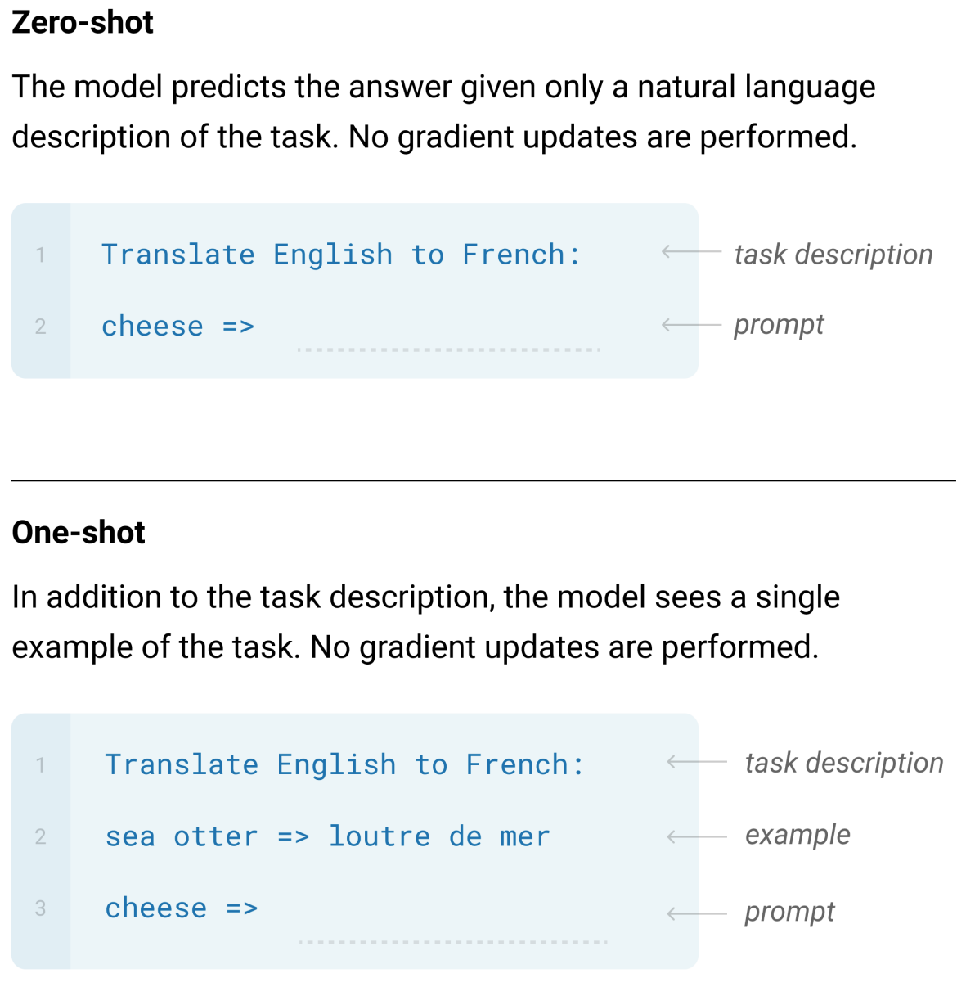
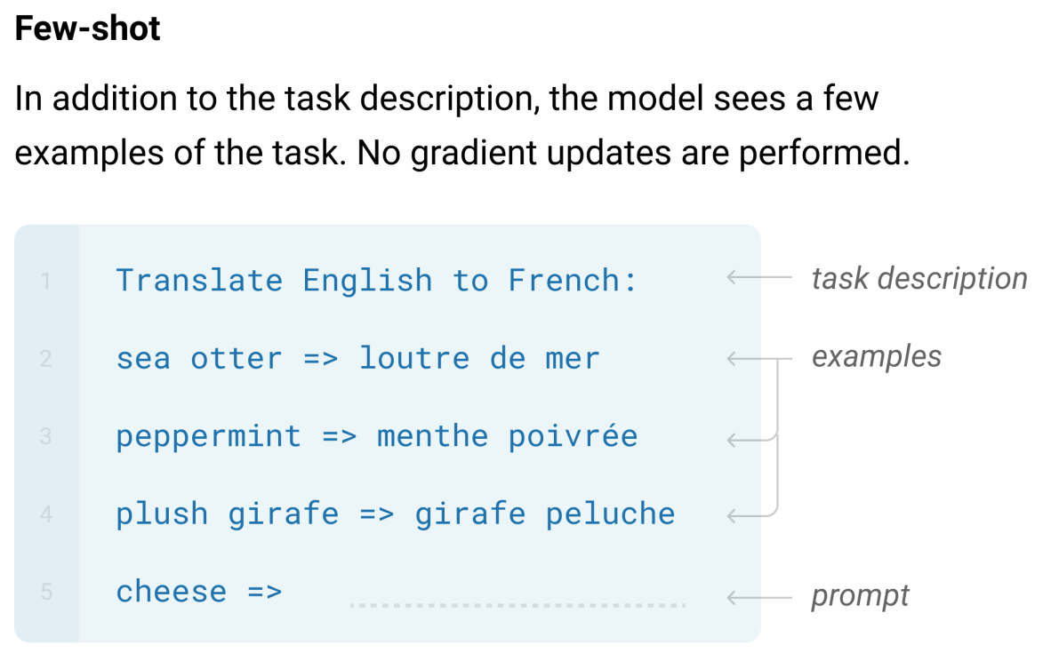
JULY 2020: GPT-3
Transformer Decoder LM (generative; auto-regressive).
Language Models are Few-Shot Learners

Slide 14
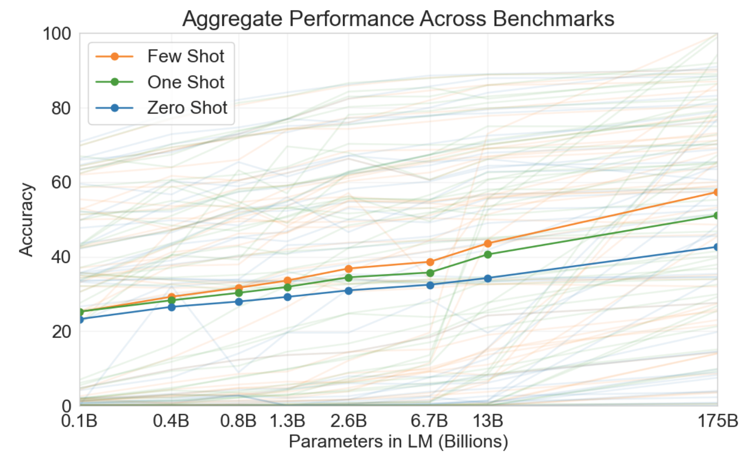
JULY 2020: GPT-3
Transformer Decoder LM (generative; auto-regressive). Same as GPT2
Language Models are Few-Shot Learners

Slide 15
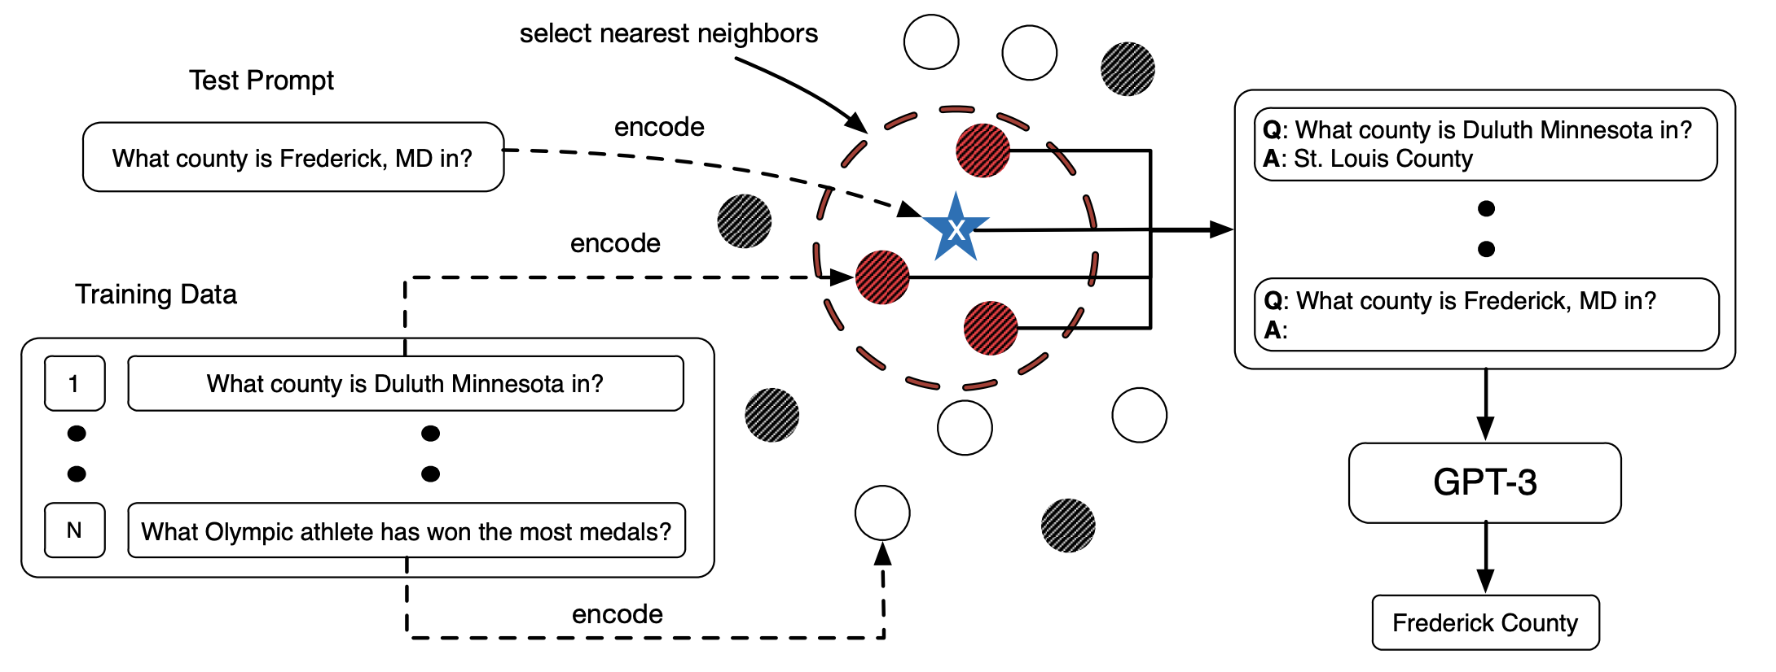
JAN 2021: In-Context Learning (Prompt Engineering)
Issue: When prompting Generative LMs, the prompt examples matter a lot Natural question: how can we select useful examples for our prompt?
What Makes Good In-Context Examples for GPT-3?

Slide 16
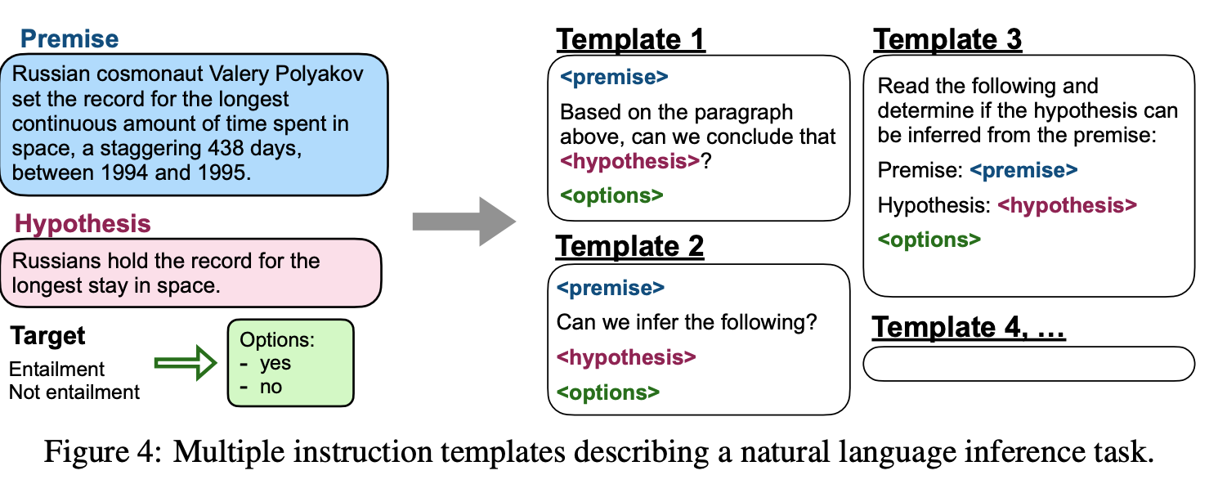
FEB 2022: Finetuned LMs are zero-shot learners
Finetuning language models on a collection of tasks described via instructions (aka instruction tuning) is really useful
FINETUNED LANGUAGE MODELS ARE ZERO-SHOT LEARNERS

Slide 17
APRIL 2022: PaLM
540B param model a single general LM for many domains
PaLM: Scaling Language Modeling with Pathways

Slide 18
APRIL 2022: PaLM
540B param model a single general LM for many domains
Explaining a joke
PaLM: Scaling Language Modeling with Pathways

Slide 19
JUNE 2022: BIG-Bench
204 tasks, created by 442 authors from 132 institutions
Beyond the Imitation Game: Quantifying and extrapolating the capabilities of language models

Slide 20
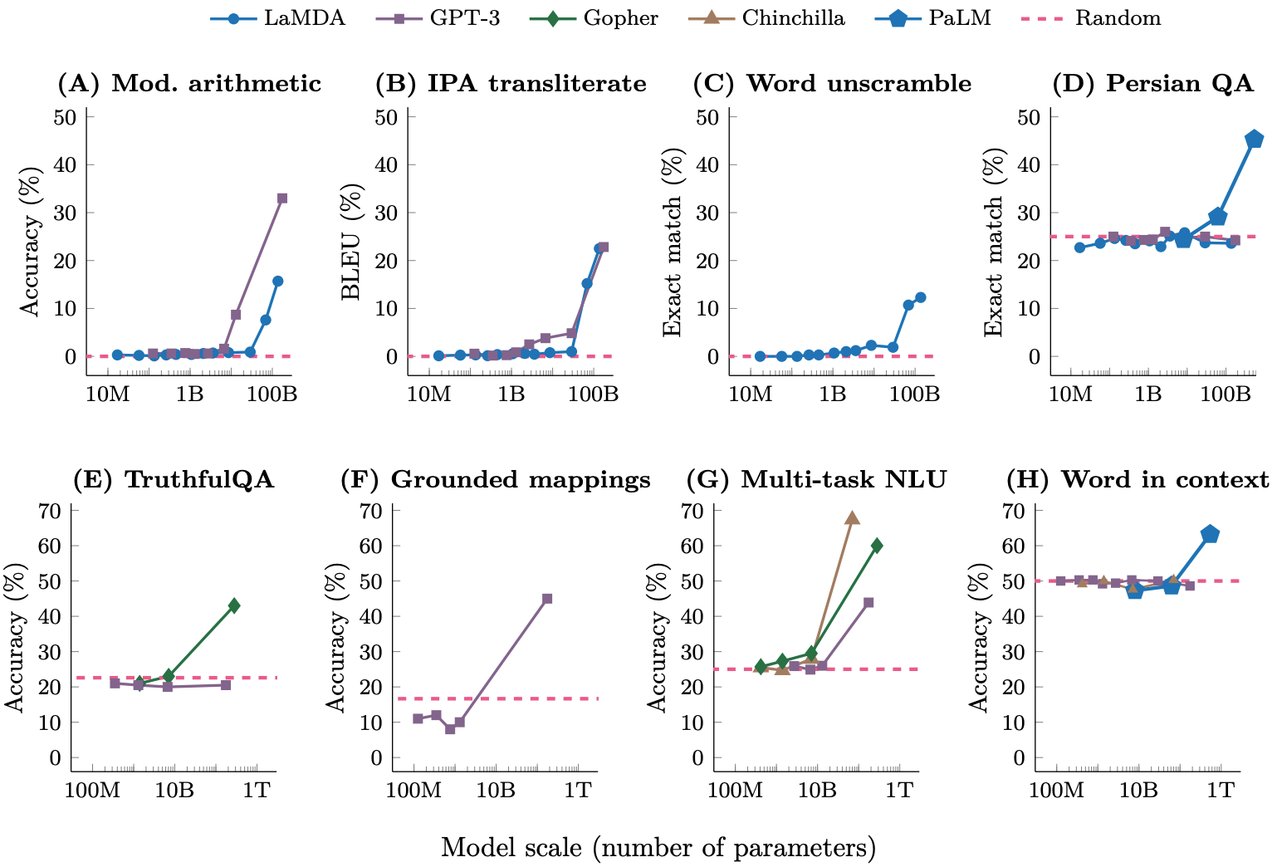
OCT 2022: Large LMs become magical
LLMs with 100 billion parameters exhibit emergent abilities!
Emergent Abilities of Large Language Models

Slide 21
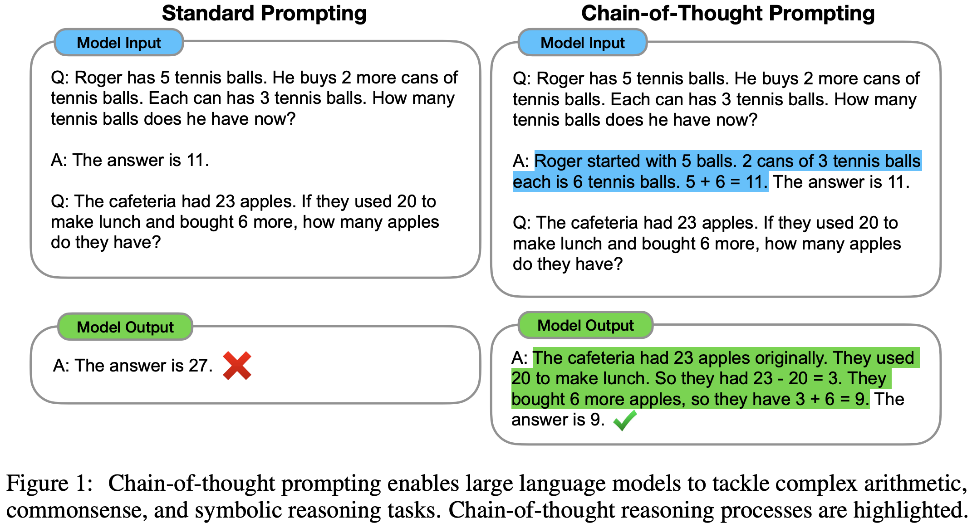
OCT 2022: Chain-of-thought improves LMs’ reasoning
Guide LMs to do complicated tasks that require some reasoning!
Chain-of-Thought Prompting Elicits Reasoning in Large Language Models

Slide 22
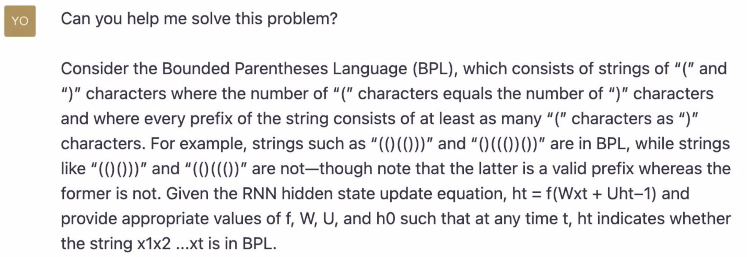
NOV 2022: ChatGPT
Yoon Kim (MIT) asked ChatGPT one of our NLP homework problems.

Slide 23
NOV 2022: ChatGPT
Yoon Kim (MIT) asked ChatGPT one of our NLP homework problems.

Slide 24
OUTSTANDING ISSUES IN NLP
Areas
Model efficiency (e.g., Mixture-of-Experts, quantization, LoRA)
Developing models that outperform transformers (e.g., SSMs, Mamba)
Make models safe and robust?
How to minimize bias and align with human values (all humans?)
Interpretability and explainability
Multi-modal (images, videos, text)
Multi-lingual (especially low-resource languages)

Slide 25
OUTSTANDING ISSUES IN NLP
Hot Problems and Specific Approaches
RAG (retrieval-augmented generation)
Agents (LLMs with tailored specialties and can interact with other software/systems)
Conduct “research” for a user while providing citations
Customer service/support
Full-fledge software development (not just generating code that might work)
Tokenization (how to best process and representing your input data)

