Slide 1
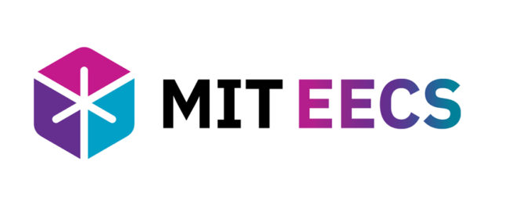


Multimodal AI
1
Paul Liang
Assistant Professor
MIT Media Lab & MIT EECS
https://pliang279.github.io
ppliang@mit.edu
@pliang279

Slide 2
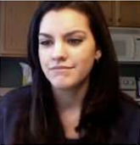
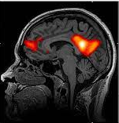
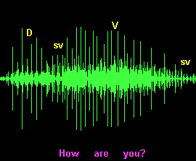
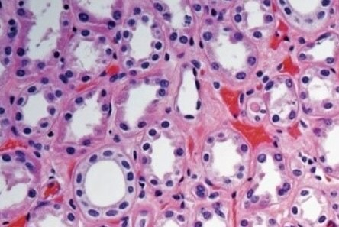

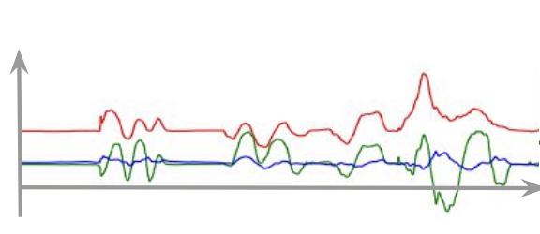


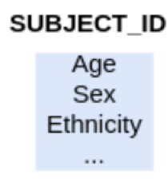


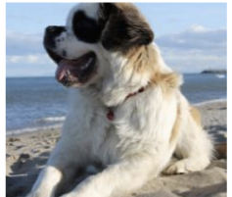



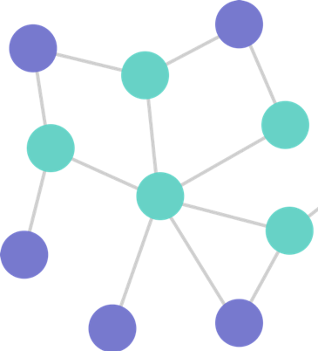

2
Foundations of Multisensory AI
Gestures
Radiology
Voice
Histology
Multisensory world
Spoken words
Sensors
Wearables
Tables
Mobile
Vision
Emotional
states
Activities
Networks
Movement

Slide 3
3
Multimodal AI – Surveys, Tutorials, Courses
Foundations and Recent Trends in Multimodal Machine Learning
Paul Liang, Amir Zadeh and Louis-Philippe Morency
☑ 6 core challenges
☑ 50+ taxonomic classes
☑ 700+ referenced papers
https://arxiv.org/abs/2209.03430
Tutorials: ICML 2023, CVPR 2022, NAACL 2022
Courses: see https://pliang279.github.io/

Slide 4

4
What is Multimodal?
Why is it hard?
What is next?
Heterogeneous
Multimodal is the scientific study of heterogeneous and interconnected data ☺
Connected
Interacting
$$y$$

Slide 5

5
Summary of Core Multimodal Challenges
Representation
Generation
Reasoning
Quantification
Alignment
$$\hat{y}$$
Transference

Slide 6
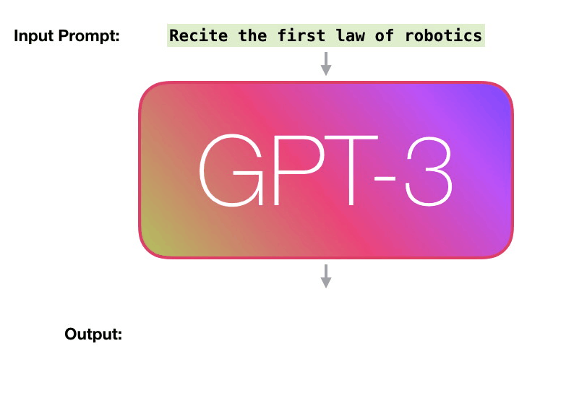
6
Recap: Large Language Models
Question answering
Open-ended dialog
Translate to different languages
Retrieve news
Solving math problems
Writing code
and more…
[Brown et al., Language Models are Few-shot Learners. NeurIPS 2020]

Slide 7
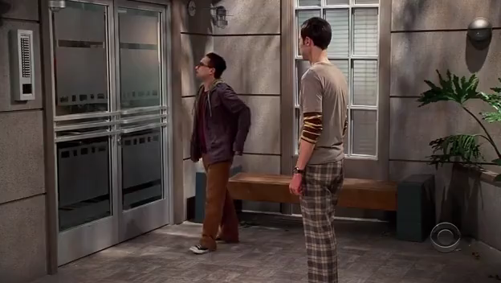
7
From Large Language Models to Multimodal Models
Classification: What is the tone of the man in the grey shirt?
Open-ended: Describe the relationships between these 2 people.
Explanation: Explain why, citing visual and verbal evidence.
Generation: Animate a story inspired by this short video clip.
Counterfactual: What if these people were from a different society or culture?
[Liang, Zadeh, and Morency. Foundations and Trends on Multimodal Machine Learning. ACM Computing Surveys 2024]

Slide 8
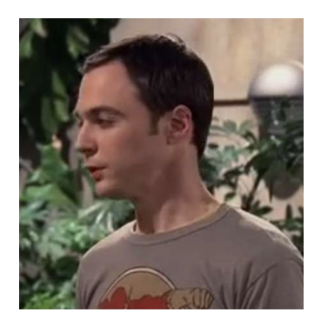
8
Large Multimodal Models
Part 1: Multimodal foundation model representations of text, video, audio
It’s just a privilege to watch your mind at work.
Multimodal representation

Slide 9
9
Large Multimodal Models
Part 2: Adapting large language models for multimodal text generation
It’s just a privilege to watch your mind at work.
This person is being sarcastic.
They seem to be close friends.
Multimodal representation

Slide 10
10
Large Multimodal Models
Part 3: Enabling multimodal generation
It’s just a privilege to watch your mind at work.
This person is being sarcastic.
They seem to be close friends.
Multimodal representation
+
(quote previous episodes)
(highlight multimodal information)

Slide 11

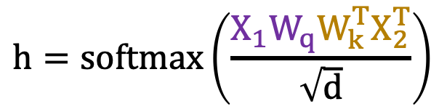
11
Aligned
Representation
Multimodal Transformers
3 x 4
(weighted) outer product
Vision-to-language attention
(row) normalize to 0-1
It’s just a privilege to watch your mind at work.
3 x d
d x 4
mind
privilege
4 x d
privilege
0.7
0.3
$$h=softmax\left(\frac{X_{1}W_{q}W_{k}^{T}X_{2}^{T}}{\sqrt{d}}\right)$$
mind
1.0
$$X_{2}W_{v}$$
vocal
emphasis
eye-roll
vocal
emphasis
eye-roll
normalize wrt dimension d
privilege
mind
vocal
emphasis
Sarcasm
eye-roll
New language representation contextualized with vision
[Liang et al., Multimodal Language Analysis with Recurrent Multistage Fusion. EMNLP 2018]
[Tsai et al., Multimodal Transformer for Unaligned Multimodal Language Sequences. ACL 2019]

Slide 12
12
From Text to Multimodal Generation
It’s just a privilege to watch your mind at work.
This person is being sarcastic.
They seem to be close friends.
Multimodal representation
+
(retrieve next episode)
(highlight multimodal evidence)

Slide 13
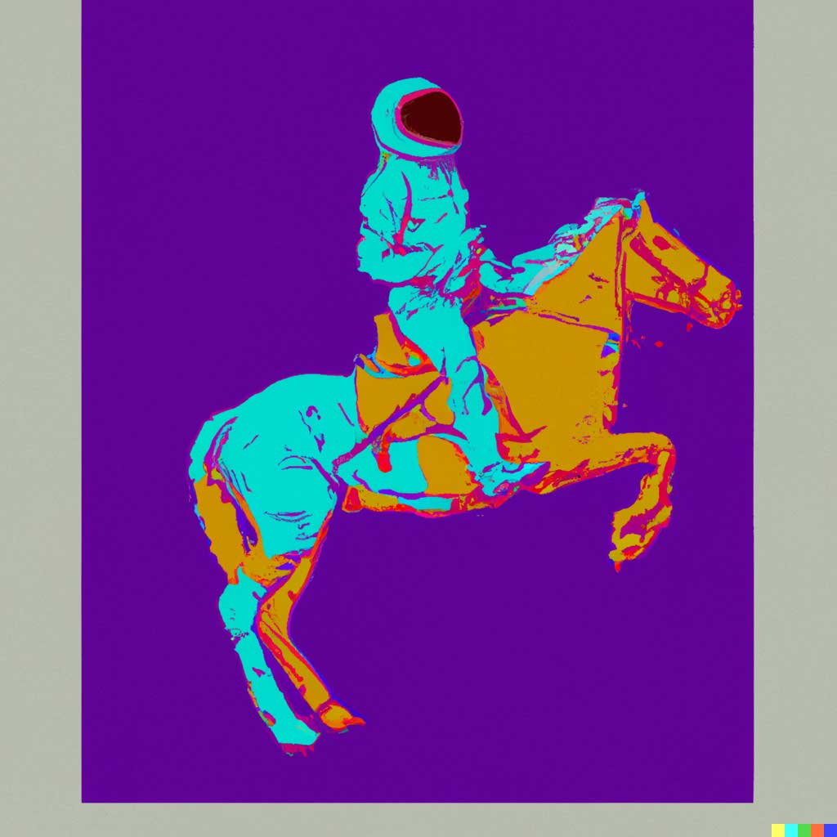

13
Generation:
Translation
From Text to Multimodal Generation
An astronaut riding a horse in the style of Andy Warhol.
A bowl of soup that is a portal to another dimension as digital art
[Ramesh et al., Hierarchical Text-Conditional Image Generation with CLIP Latents. arXiv 2022]

Slide 14
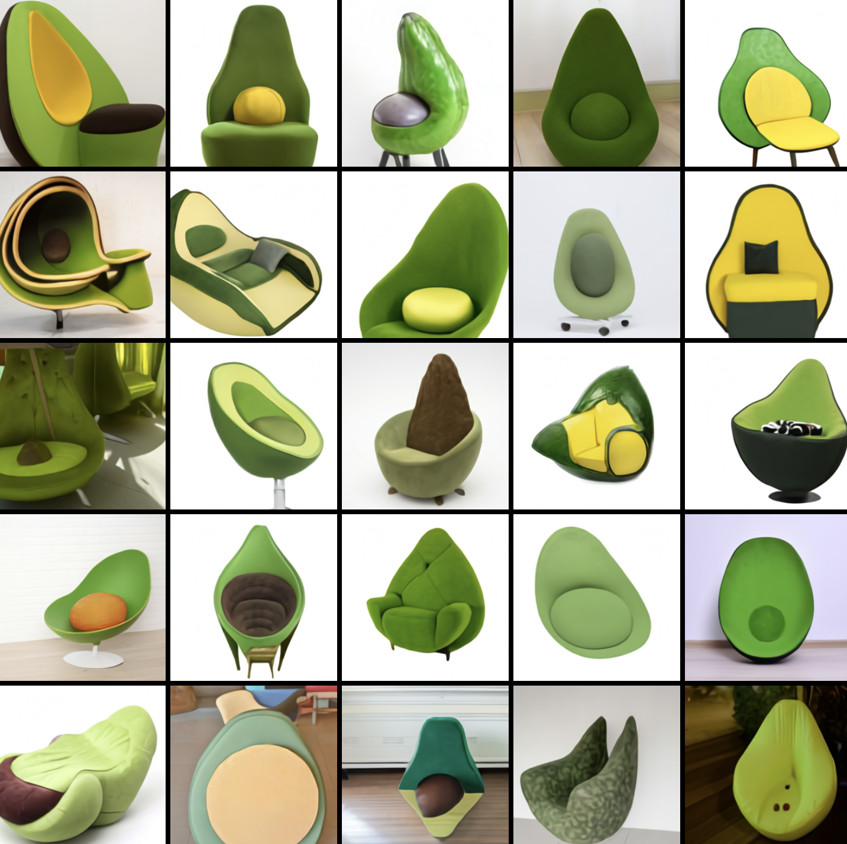
14
Generation:
Translation
From Text to Multimodal Generation
Directly training diffusion models with conditional information
Conditional latent variables are pretrained CLIP embeddings, then diffusion model to generate image.
1
CLIP encoder
CLIP
encoder
2
Autoregressive model
An armchair in the shape of an avocado.
CLIP image
embedding
Text
encoder
Diffusion model
3
Generation
[Ramesh et al., Hierarchical Text-Conditional Image Generation with CLIP Latents. arXiv 2022]

Slide 15
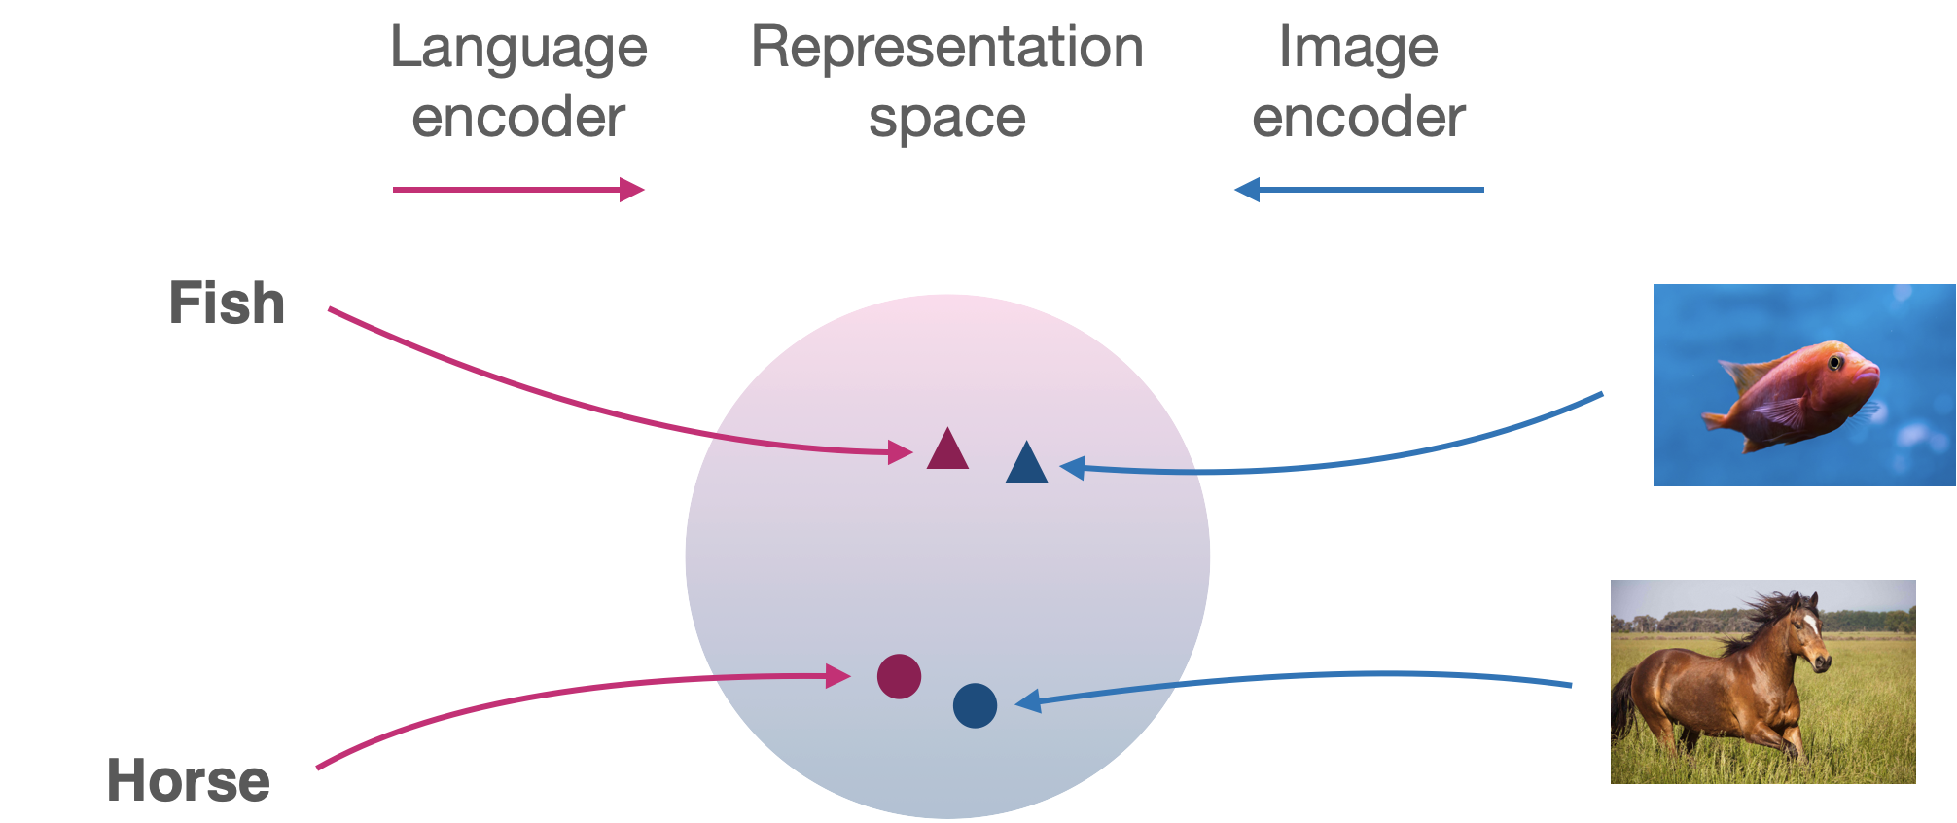



15
Representation
Coordination
Contrastive Language Image Pretraining
Representation
space
A red fish swimming in the sea…
$$z_{i}$$
$$z_{j}$$
$$z_{k}$$
Pull together
Push apart
[Radford et al., Learning Transferable Visual Models From Natural Language Supervision, ICML 2021]

Slide 16


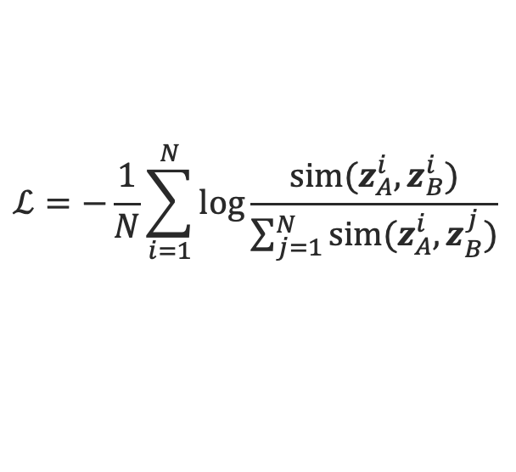
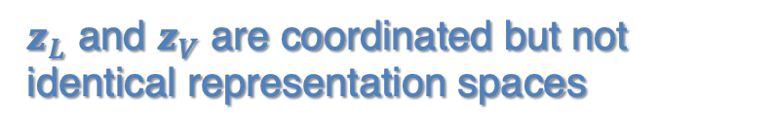

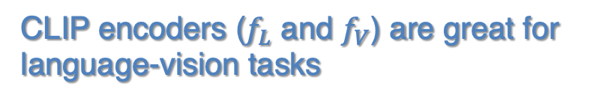

16
Representation
Coordination
Contrastive Language Image Pretraining
$$z_{L}$$
Language
encoder
Popular contrastive loss: InfoNCE
$$f_{L}$$
positive pairs
encoder
$$ℒ=−\frac{1}{N}\sum_{i=1}^{N}{log}\frac{sim(z_{A}^{i},z_{B}^{i})}{\sum_{j=1}^{N}{sim(z_{A}^{i},z_{B}^{j})}}$$
Visual
(image)
$$z_{V}$$
$$f_{V}$$
Positive and negative pairs:
negative pairs
Similarity function can be cosine similarity
and positive pairs
CLIP encoders ($f_{L}$ and $f_{V}$) are great for language-vision tasks
Contrastive pre-training
$z_{L}$ and $z_{V}$ are coordinated but not identical representation spaces
[Radford et al., Learning Transferable Visual Models From Natural Language Supervision, ICML 2021]

Slide 17
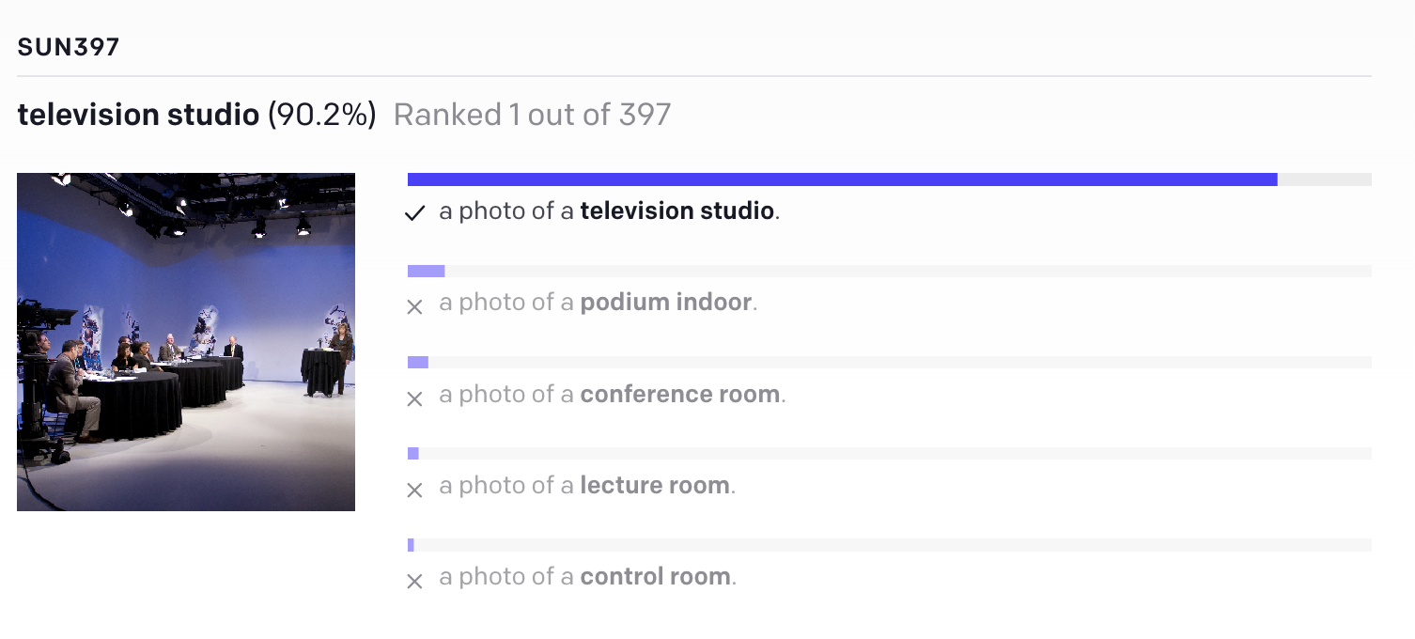
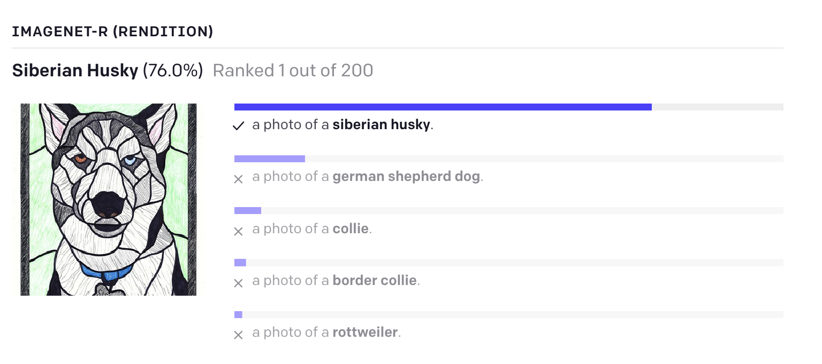
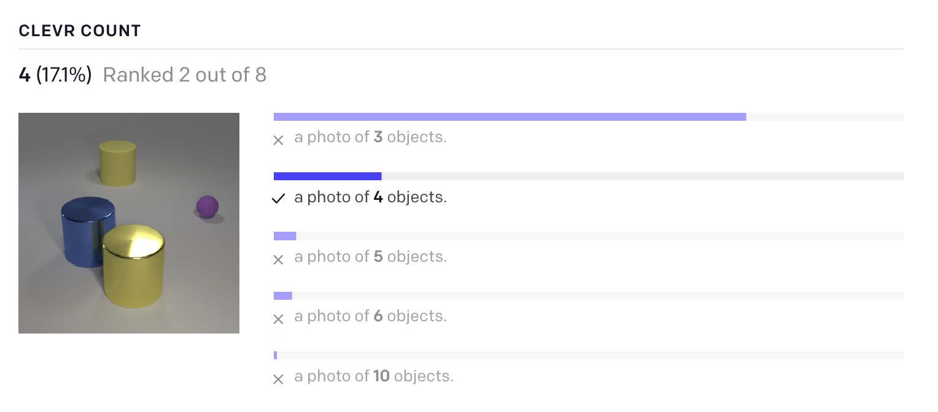
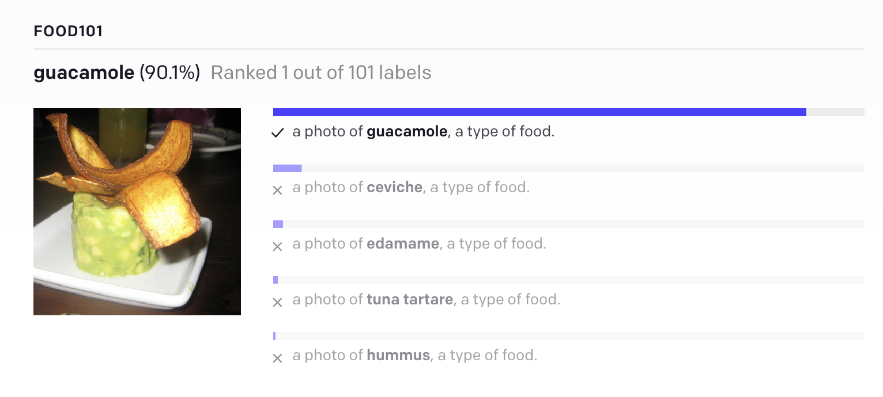
CLIP (Contrastive Language–Image Pre-training)
17
Representation
Coordination
[Radford et al., Learning Transferable Visual Models From Natural Language Supervision, ICML 2021]

Slide 18
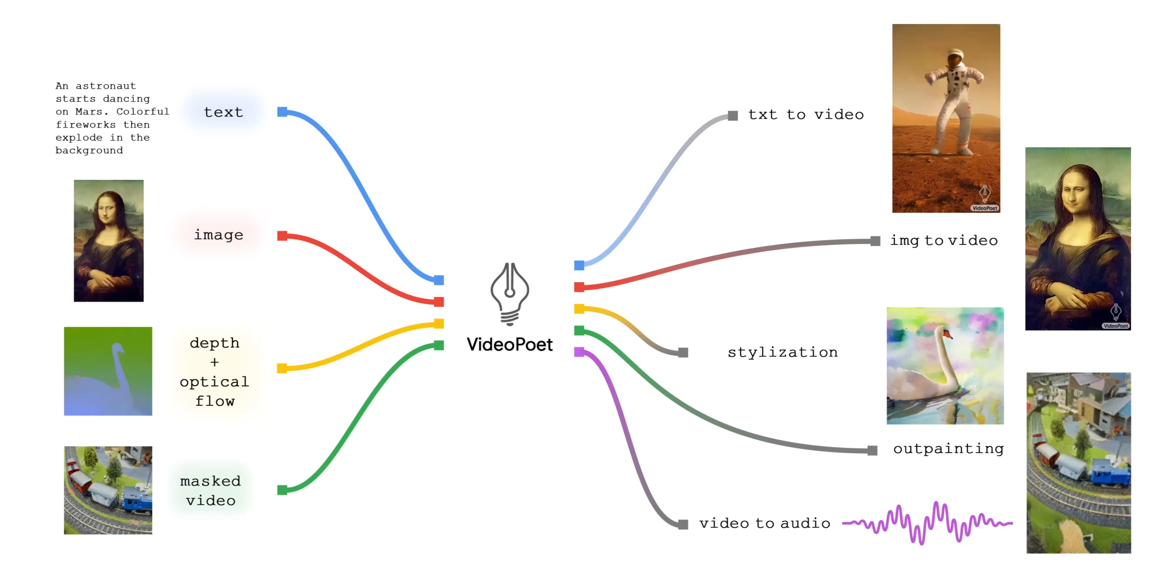
18
Multimodal Generative AI
Multimedia, content creation, creativity and the arts
[Kondratyuk et al., VideoPoet: A Large Language Model for Zero-shot Video Generation. ICML 2024]
[Han et al., Progressive Compositionality in Text-to-Image Generative Models. ICLR 2025]

Slide 19
19
What is Multimodal?
Why is it hard?
What is next?
Representation
Multimodal transformers
Heterogeneous
Alignment
Reasoning
Multimodal LLMs
Connected
Generation
CLIP
Transference
Text-to-image
Interacting
Quantification
Generative AI
Paul Liang
https://pliang279.github.io
ppliang@mit.edu
@pliang279

